Slide 1



TO CHALLENGE
COMPLEXITY
WE BRING NEW PERSPECTIVES
TO MAKE OUR CLIENTS´ LIVES EASIER

Slide 2


Client Segmentation
19/04/2022
Proposal to Sense Assurance ㋏

Slide 3










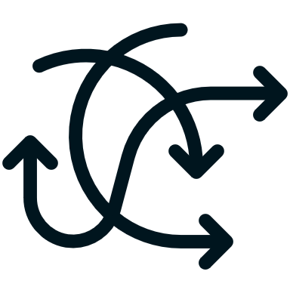

index
1. Goal
6. Challenges
The problem at hands
Questions faced in the project
2. Data
7. Technical Details
Data provided to us
How the solution was built
3. Proposal
8. Delivery
Our solution proposal
Deliver the product
4. Results
9. Next Steps & Suggestions
The solution results
What can we do next?
5. Roadmap
10. Q&A
Steps to build the solution
Discussion
3

Slide 4


Goal
The Problem at hands
4

Slide 5

Sense Assurance marketing problem
The Marketing department came to us with a problem. Their volume of clients is increasing rapidly, and they are having difficulties profiling their old and new clients.
They want to automate their client profiling. Technically, these are client segmentations.
The segmentation goal is to answer these questions
Most valuable clients currently;
Most valuable clients in the future;
Customers who have certain Lines of Business (LOB’s);
5
Notes:
João

Slide 6
Data
Data provided to us
6

Slide 7


provided data
Sense Assurance provided us with a dataset composed of ~10k clients information. The data goes from year 1974 to 1999.
These features are:
About the client
Age;
Degree of Education;
Monthly Salary;
If has children;
Living Area;
About the business
First Policy Year
Customer monetary value;
Claims Rate
Premium: Motor
Premium: Household
Premium: Health
Premium: Life
Premium: Work Insurance
7
7
Notes:
Jão

Slide 8

Proposal
Our solution proposal
8

Slide 9


proposal
Our goal is to segment the clients in ways that describe meaningful patterns.
The goal questions are the basis to evaluate these patterns.
Thus, we propose an unsupervised solution to this problem. The quality of the solution is weighted by sophisticated metrics, but also by analysing the segments to assess the obtained patterns answer the goal questions.
Unsupervised Clustering proposed methods
Kmeans
DBSCAN
Agglomerative Clustering
9
Notes:
João

Slide 10

Results
The solution results
10

Slide 11
Customer Scorer Model
This model was constructed with the DBSCAN algorithm. Its goal is to segment the customers by their value and future value to the company.
Segment Avg Age & High CMV (n=2193)
Business should hold them, but they are highly valuable already.
Segment Avg Age & Low CMV (n=2681)
Business could try to increase premiums of these highly volatile customers.
Segment Old Age & Avg CMV (n=2353)
These have higher yearly salary it might be possible to increase their values with higher premiums.
Segment Young Age & Avg CMV (n=2841)
These are clients whose monetary value could be increased over time with marketing campaigns.
11
Notes:
Pedro

Slide 12
Customer Scorer Model
Other considerations
The premiums are also slightly different between the segments. The customers who pay higher premiums in Motor, are also those who either are highly valuable or almost a burden to the company. The more stable customers search for different products.
Pros e Cons of DBSCAN (the algorithm used)
Pros:
Fast training;
Outlier rubust;
Cons:
Unstable;
Difficult to parametrize;
Silhouette: 0.06 | Variance Criterion Ratio: 2745 | Davies Bouldin Score: 4.56
12
Notes:
Pedro

Slide 13
Customer Lobs Model
This model was constructed with the Agglomerative Clustering algorithm. Its goal is to segment the clients who have more tendency to certain Lines of Business.
Segment Average Customer (n=3723)
Has an average premium on every LOB.
Segment HouseLife (n=1195)
Customers have above average premiums on House and Life.
Segment Motor (n=4669)
Highest paying customers on the Motor LOB.
Segment HouseHealth (n=419)
These customers have above average premiums on Household and Health.
Segment Low Value (n=237)
The company owns, on average, money to these customers in the Household Line of Business.
13
Notes:
Pedro

Slide 14
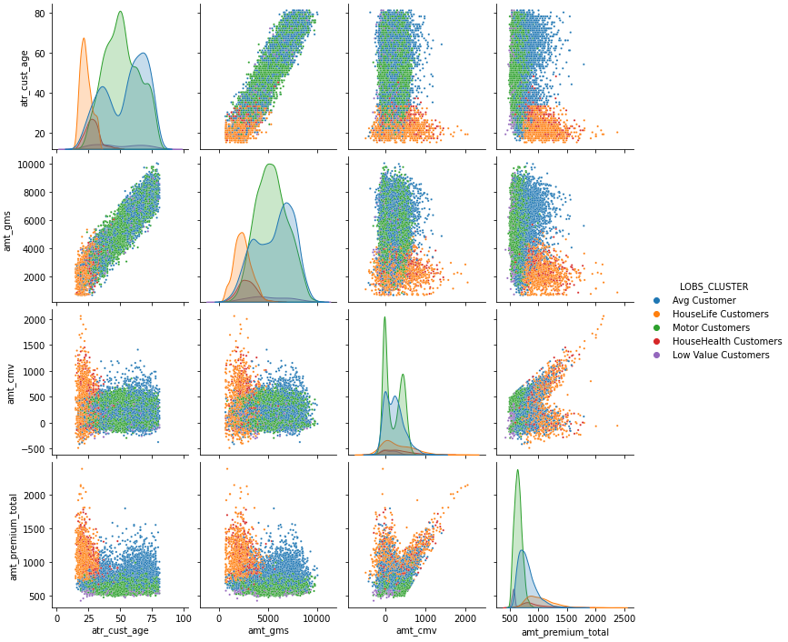
Customer Lobs Model
Other considerations
The Age (atr_cust_age), Gross Monthly Salary (amt_gms), Customer Monetary Value (amt_cmv) and Total Premium (amt_premium_total) are not well separated in this segmentation.
Pros e Cons of Agglomerative Clustering
Pros:
Fast training;
Easy to parametrize;
Cons:
Unstable;
No direct way to segment new observation;
Silhouette: 0.003 | Variance Criterion Ratio: 809 | Davies Bouldin Score: 2.68
14
Notes:
Pedro

Slide 15

Roadmap
Steps to build the solution
15

Slide 16











roadmap
(1)
(3)
(5)
Business Goals
Business Questions
Model Deployment
(2)
(4)
Business Questions
EDA
Feature Selection
Project Delivery
Model Training
(6)
Feature Engineering
Model Evaluation
Continous Evaluation
Continuous Training
16
Notes:
Helder

Slide 17

Challenges
Questions faced in the project
17

Slide 18


EDA
Outliers
New Features
From understanding the data until which transformations to make.
How do we define outliers and how to treat them.
What are the limits, and if these features make sense.
What was the last year of the dataset?
The customer age is when he became customer, or current age?
What trends and patterns are we searching for?
Which decisions to take based on the data we were observing?
Do we use simpler methods as in interquartile range to define outliers?
If instead we do binning, do we leave those observations in the dataset?
What are the pros and cons of leaving the outlier candidates?
How much time should we devote to brainstorming and creating new features?
How do we validate their meaning in the real world?
Are they useful to the questions we are trying to answer?
18
Notes:
Helder – Ler Questões

Slide 19
Engineering
Selection
Models
The best way to work and transform a feature.
Select features that reflect our needs.
Build models that answer our needs.
Do we use MinMax, Standard Scale or Log a feature?
Should we apply binning? Quantiles or Tree based bins?
How do we handle many new features, highly correlated between themselves?
How to choose the appropriate features to feed into models posteriorly?
How do we search for these? Intuition or with a methodology?
Is the evaluation of these qualities reflected on the model segments?
How do we define a quality threshold to stop searching for better features?
What metrics to use to evaluate the quality of the segments?
Which models should we try to use in our experiments?
When can we say a model is good enough to deliver?
How do we deliver this model?
19
Notes:
Helder - Same

Slide 20

Technical Details
How we built the solution
20

Slide 21


Exploratory Data Analysis
When exploring the data, we found some challenges in understanding the data, and we overcame them by taking decisive actions. We used Jupyter Notebooks for this part, because it allows us to explore the data graphically in real-time with ease.
What was the last year of the dataset?
The customer age is when he became customer, or current age?
What are the pros and cons of leaving the outlier candidates?
Which decisions to take based on the data we were observing?
Because we had no previous information, we pivoted the First Policy Year feature as being the reference year. This resulted in 1998 as the dataset year, by being the last date to appear in this feature.
We still used the Customer Age feature as the client age feature, but found out that feature + the number of years since the first policy made a bit more sense as his current age.
In this phase we just looked at anything that might make sense to segment the clients, but all we found was outliers and a degree of homogeneity in the data distributions. Except linear correlations between some features.
The data, as said, had linear correlations, we decided to maintain and be careful with these. The major outliers were removed based on graphical representations, with the help of the interquartile technique. And we added new features.
21
Notes:
Helder

Slide 22
EDA
Dealing with duplicates, nulls and data types
Column | Filled Values | Nulls | Type
First year policy | 10266 | 30 | Float
Customer age | 10279 | 17 | Float
Educational degree | 10279 | 17 | Object
Gross monthly salary | 10260 | 36 | Float
Geographic location area | 10295 | 1 | Float
Has children | 10295 | 21 | Float
Customer monetary value | 10296 | 0 | Float
Claim rate | 10296 | 0 | Float
Premium in LOB: Motor | 10262 | 34 | Float
Premium in LOB: Household | 10296 | 0 | Float
Premium in LOB: Health | 10253 | 43 | Float
Premium in LOB: Life | 10192 | 104 | Float
Premium in LOB: Work compensation | 10210 | 86 | Float
3 duplicates were removed
Rows with null data for children were removed
First year policy, customer age and has children were converted to ints
Null values filled with the mean using KNN Imputer
10272 rows
22
Notes:
Helder

Slide 23
Outliers
Outliers can be difficult to work with. There’s always the risk of removing interesting and valuable data points. We had a lot of questions, mainly on where to draw the line and how to draw it.
Do we use simpler methods as in interquartile range to define outliers?
If instead we do binning, do we leave those observations in the dataset?
What are the pros and cons of leaving the outlier candidates?
Using this method resulted in 502 outliers to be removed, but most of them still made sense, mainly in the LOB Life, so we just used this method as support for decision making.
Since we took a decisive approach when removing outliers, we didn’t experiment with this alternative too much. In the end, we only did binning in the age feature.
We found it very difficult to see graphical representations of the data when we kept the outliers. Initially, we marked them in a dummy feature, but opted to not include these observations in the models, so we revised the code and removed them in the end.
23
Notes:
Helder

Slide 24
Outliers
Our approach was, with the support of interquartile ranges, detect and remove extreme or abnormal data points. This approach intention was to keep as much information as possible.
Mark candidates using Interquartile range
Analyse outlier candidates
Manually remove extreme or abnormal data
28 outliers
Resulting dataset
10244 rows
24
Notes:
Helder

Slide 25
Feature engineering
Old Columns | MinMax | Standard | Log | Square Root | Description
atr_cust_age | X | X |  |  | Customer age
dt_fpy | X | X |  |  | Date when the customer activated the policy
amt_gms | X | X |  | X | Custoemr gross monthly salary
amt_cmv |  |  |  | X | Customer monetary value
amt_plob_X | X | X | X |  | Amount of premium customer pays for each line of business
New Columns | MinMax | Standard | Log | Square Root | Description
atr_fpy_to_date | X | X |  |  | How many years since first policy year to year of reference (1999)
amt_premium_total |  | X |  |  | Sum of every premium for a customer
outlier_candidate |  |  |  |  | Marked values that were above or below 1.5 times the interquartile range
rt_plob_X |  |  |  |  | Rates of each type of premium
amt_gys | X | X |  | X | Yearly customer salary
amt_claims_total |  |  |  |  | Total claims made by customer by multiplying claims rate with the total of premiums
rt_premiums_year |  |  |  |  | Cost of premiums in relation to customer yearly income
rt_claims_year |  |  |  |  | Rate of claims made per yearly income
fe_bin_plob_X | X (_scaled) | X | X |  | Tree based binning for each type of premium (Target: Total Premium)
fe_bin_cmv_X | X (_scaled) |  |  |  | Tree based binning for each type of premium (Target: Customer Monetary Value)
fe_bin_cust_age |  |  |  |  | Customer age binned
Legend:
X: Motor, Household, Life, Health and Work Compensation
rt : rate
dt : date
amt :amount
atr : atribute
25
Notes:
João

Slide 26
Feature Selection
Method
Select a threshold
Results
Choose the number of features, a min and max number of clusters;
Loop from k min to k max while recording metrics of every combination of features;
Pick the feature giving the best value overall over the metrics
Repeat steps 2 and 3 until the desired number of features is reached
Since we built two different segments, with two different algorithms, the thresholds were different. Initially, we used the Silhouette Score, but it wasn’t enough. In the end, both the Variance Criterion Ratio and the Davies-Bouldin Score were observed to evaluate the quality of the models.
The results were adapted from the forward selection by our greedy algorithm implementation. The metrics were being recorded to MLFlow, and with its aid, we chose the features that were giving the best results.
26
Notes:
João

Slide 27

Models
The used features for each of the models were obtained with the help of MLFlow and the defined metrics.
SCORER* Model
LOBS Model
log_rt_plob_household
log_rt_plob_motor
rt_premiums_year
rt_plob_household
log_rt_plob_wcomp
rt_cr
fe_bin_int_cust_age
fe_amt_plob_health_scale
norm_fpy_to_date
fe_amt_plob_life_scale
norm_amt_premium_total
fe_amt_plob_household_scale
fe_amt_plob_motor_scale
*Part of this model was developed manually. See Annex
27
Notes:
João
Rt – Rate to toal Log – Logarithm
RT premium – Total Premium paid to gross yearly income
Rt cr –Claims Ratio
Int cust age – Quartile partition of customer ages
MinMax scaling of resulting classes from Decision Trees
Norm - normalization

Slide 28
Delivery
Deliver the product
28

Slide 29
Delivery
Models
Git Repository
Presentations
The models are to be delivered in a pickle format. Since they were recorded in the MLFlow framework, they can be acessed through its API.
The Git repositor with all the developed work, including jupyter notebooks and pipeline scripts.
This presentation and a Powerbi Application with some reports on the data and the cluster results.
29
Notes:
João

Slide 30

Next Steps & Suggestions
What can we do next?
30

Slide 31




Suggestions
Next Steps
More features
Professional Occupation
Gender
Address / Location (More granularity)
Customer historic (Active/Left company, etc)
Number of activated claims. By LOB
Test more algorithms and segments;
Validate the results with Business;
Deploy the models;
Implement continuous evaluation and retraining alerts.
31
Notes:
Pedro
PowerBI

Slide 32

PowerBI App
32

Slide 33
Q&A
33

Slide 34

Annexes
34

Slide 35
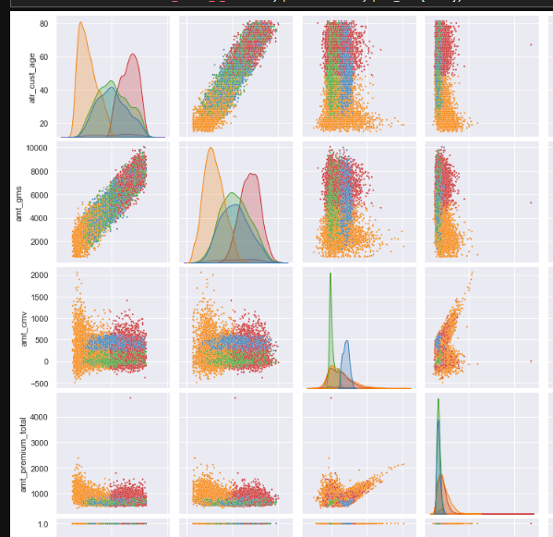
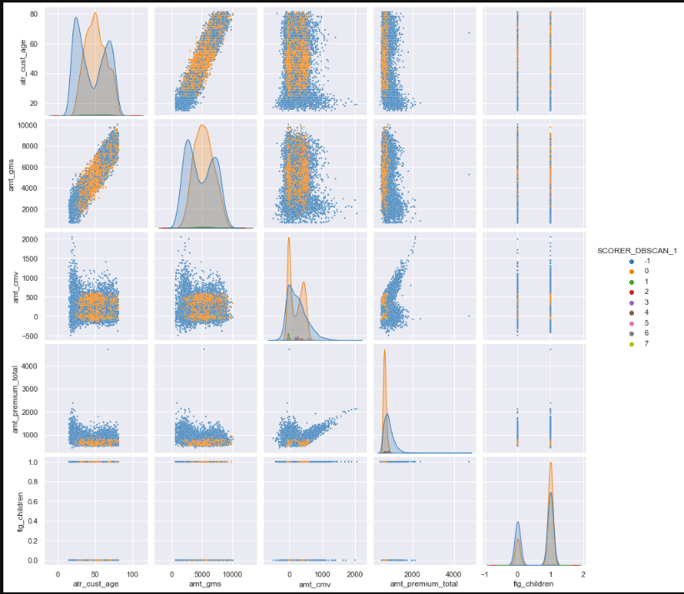
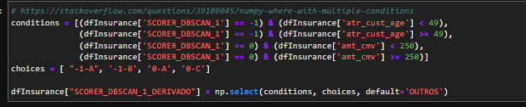
Scorer Model
The manual part was done after seeing interesting results with the algorithm
Clusters resultant of DBSCAN
Manual correction
Resulting distributions
35
Notes:
João
Rt – Rate to toal Log – Logarithm
RT premium – Total Premium paid to gross yearly income
Rt cr –Claims Ratio
Int cust age – Quartile partition of customer ages
MinMax scaling of resulting classes from Decision Trees
Norm - normalization

